Slide 1
DISTRIBUTED DATABASE

Slide 2
A distributed database is essentially a database that is dispersed across numerous sites, i.e., on various computers or over a network of computers, and is not restricted to a single system.
A distributed database system is spread across several locations with distinct physical components.
A distributed database system consists of loosely coupled sites that share no physical component
Database systems that run on each site are independent of each other
Transactions may access data at one or more sites
A database which is distributed over some form of network to bring down the cost or the difficulty in accessing data and to increase the efficiency of the whole system.

Slide 3
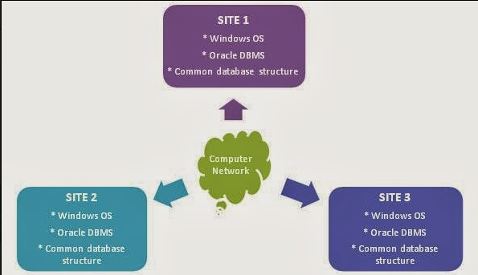
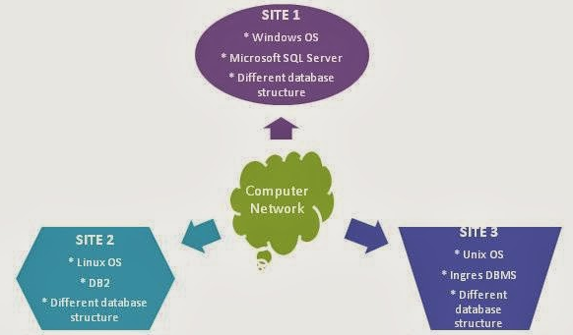
Types of Distributed Databases:
1. Homogeneous Distributed Database
2. Heterogeneous Distributed Database
Homogeneous Distributed Database
Heterogeneous Distributed Database

Slide 4
Homogeneous & Heterogeneous Distributed Databases
Homogeneous Distributed Database
Identical software are used in all the sites
Here, a site refers to a server which is part of the distributed database system
Software would mean OS, DBMS software, and even the structure of the database used
In some cases, identical hardware are also used
All sites are well known.
As they are similar in terms of DBMS software and hardware used, are aware of each other and agree to cooperate in processing user requests.
Partial control over the data of other sites
As we know the structure of databases, software and hardware used in other sites, each site surrenders part of its autonomy in terms of right to change schemas or software. Hence the partial control over the data is possible.
Looks like a single central database system
A homogeneous database stores data uniformly across all locations. All sites utilize the same operating system, database management system, and data structures. They are therefore simple to handle.

Slide 5
Homogeneous & Heterogeneous Distributed Databases
Heterogeneous Distributed Database
Different sites uses different database schemas and software
Difference in schema is a major problem for query processing
Difference in software is a major problem for transaction processing
The structure of databases reside in different sites may be different (because of data partitions)
Co-operation between sites are limited. That is, it is not easy to alter the structure of the database or any other software used.
Sites may not be aware of each other and may provide only limited facilities for cooperation in transaction processing
Various operating systems and database applications may be used by various machines. They could even employ separate database data models. Translations are therefore necessary for communication across various sites.

Slide 6
Why Distributed Database?
We are interested in Distributed database for various reasons. Some of them are;
Data are always available to end users, i.e., they are easily accessible. The availability makes the total system reliable.
Distributed database increases the performance of the overall system. Because, the servers are available near the place where it is very much needed.
Support organizational growth. Because, the distributed database structure would not cause stopping of all ongoing services. Only new distributed server may need to be established to handle the new details.
Handling addition of any server, modification of existing modules etc. are easy.
Distributed data handling increases the parallelism. That is, a number of queries can be handled simultaneously over multiple distributed server when compared to the central server approach.

Slide 7
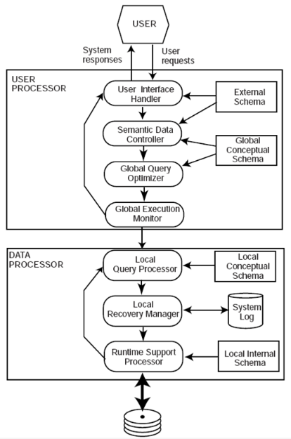
Components of Distributed DBMS Architecture
User processor and Data processor are the two major components of Distributed DBMS architecture.
These major components handle different user requests using several sub-components in a Peer-to-Peer Distributed DBMS. Those are;

Slide 8
User Processor:
User interface handler – interpreting user commands when they are given in, and formatting the result sets when the request is answered.
Semantic data controller – uses the Global Conceptual Schema to check the integrity constraints defined on database elements and also to check the authorizations on accessing the requested database.
Global query optimizer and decomposer – devises a best execution strategy to execute the given user requests in minimal cost (in terms of time, processor, memory). It is like Query Optimizer in Centralized database systems. Only exception is it has to devise a strategy which is globally optimal.
Distributed execution monitor – it is the Transaction manager. The Transaction managers of various sites that are participated in a query execution communicate with each other as part of execution monitoring.

Slide 9
Data Processor:
Local query optimizer – it optimizes data access by choosing the best access path. For example, Local query optimizer decides which index to be used for optimally executing the given query.
Local recovery manager – deals with the consistency of the local database. In case of failure, local recovery manager is responsible for maintaining a consistent database.
Run-time support processor – it accesses the database physically according to the strategy suggested by the local query optimizer. The run-time support processor is the interface to the operating system and contains the database buffer (or cache) manager, which is responsible for maintaining the main memory buffers and managing the data accesses.

Slide 10
Important considerations in distributed database over Centralized database
When compared to the centralized database system, the distributed database system should be capable of or should have the following things.
Data allocation - We need to know the answers for the following questions; What to store? Where to store? and How to store?
Data fragmentation - It is about, How one should organize the data?
Distributed queries and transactions - We must find a way to handle the data using queries and to handle transactions which are happening in multiple distributed sites (Here site means a server).

Slide 11
1. Data allocation
Data allocation deals with the establishment of servers and maintenance of data in any locations. Data allocation strategies can be made by keeping the following things in mind;
The data should be available in or near a site where it is needed most.
The storage of data in a site should increase the availability and reliability of data.
The strategy chosen for data allocation should increase the performance. That is, some of the drawbacks like bottleneck problem of central server concept or limited usability of data should be avoided.
The idea should reduce the cost involved in storage and manipulation of data
There should be a much reduced traffic or utilization of network. It should also ensure that there should never be a unnecessary use of network provided the data available near.
As a whole, data allocation deals with the where to keep the fragmented or replicated data for ease of access.

Slide 12
2. Data fragmentation
Data fragmentation is about how to break a table into fragments?, how many fragments need to be created? A table can be fragmented based on
a) what are the frequent applications accesses the data?,
b) what conditions are frequently used to access the data?, and
c) what is the simplest way of maintaining the table schema at any locations?
Here, the questions (a) and (b) mean the attributes and their values used for accessing a table frequently. For example, for the query "SELECT * FROM student WHERE campus='Mumbai'", campus='Mumbai' is the attribute name and value combination
Fragmentation is of two major types;
Horizontal fragmentation
Primary Horizontal fragmentation
Derived Horizontal fragmentation
Vertical fragmentation

Slide 13
3. Distributed queries and Transactions
When the data are fragmented or replicated and distributed over many sites in the network, then retrieval of the data involves the following;
The identification of the location of requested data,
A protocol to fetch the data, and
A way to organize the data, if it was spread over multiple sites.
Hence, Distributed Database System must be able to handle the data over the network. It just needs a special way to handle the queries and transactions over the conventional centralized database. That is, the system must understand the query and the query components and must be able to locate the data over network.

Slide 14
Distributed Data Storage
Replication
System maintains multiple copies of data, stored in different sites, for faster retrieval and fault tolerance.
This has advantages since it makes more data accessible at many locations. Moreover, query requests can now be handled in parallel.
But, there are some drawbacks as well. Data must be updated often. All changes performed at one site must be documented at every site where that relation is stored in order to avoid inconsistent results. Moreover, since concurrent access must now be monitored across several sites, concurrency management becomes far more complicated.
Fragmentation
Relation is partitioned into several fragments stored in distinct sites
To ensure there is no data loss, the pieces must be created in a way that allows for the reconstruction of the original relation.
Replication and fragmentation can be combined
Relation is partitioned into several fragments: system maintains several identical replicas of each such fragment.

Slide 15
Data Replication
A relation or fragment of a relation is replicated if it is stored redundantly in two or more sites.
Full replication of a relation is the case where the relation is stored at all sites.
Fully redundant databases are those in which every site contains a copy of the entire database.

Slide 16
Advantages of Replication
Availability: failure of site containing relation r does not result in unavailability of r is replicas exist.
Parallelism: queries on r may be processed by several nodes in parallel.
Reduced data transfer: relation r is available locally at each site containing a replica of r.
Disadvantages of Replication
Increased cost of updates: each replica of relation r must be updated.
Increased complexity of concurrency control: concurrent updates to distinct replicas may lead to inconsistent data unless special concurrency control mechanisms are implemented.


Slide 17
Data Fragmentation
Division of relation r into fragments r₁, r₂, …, r_{n} which contain sufficient information to reconstruct relation r.
Horizontal fragmentation: each tuple of r is assigned to one or more fragments
Vertical fragmentation: the schema for relation r is split into several smaller schemas
All schemas must contain a common candidate key (or superkey) to ensure lossless join property.
A special attribute, the tuple-id attribute may be added to each schema to serve as a candidate key.
Example : relation account with following schema
Account = (branch_name, account_number, balance )

Slide 18
Horizontal Fragmentation of account Relation
branch_name
account_number
balance
Hillside Hillside Hillside
A-305 A-226 A-155
500
336
62
^{account}1 ^{= σ}branch_name=“Hillside” ^{(account )}
branch_name
account_number
balance
Valleyview Valleyview Valleyview Valleyview
A-177 A-402 A-408 A-639
205
10000
1123
750
^{account}2 ^{= σ}branch_name=“Valleyview” ^{(account )}

Slide 19
Vertical Fragmentation of employee_info Relation
branch_name
Hillside Hillside Valleyview Valleyview Hillside Valleyview Valleyview
customer_name
Lowman Camp Camp Kahn Kahn Kahn Green
tuple_id
1
2
3
4
5
6
7
^{deposit}1 ^{= Π}branch_name, customer_name, tuple_id ^{(employee_info )}
account_number tuple_id
balance
A-305 A-226 A-177 A-402 A-155
500
336
205
10000
62
1
2
3
4
5
A-408 | 1123 | 6
A-639 | 750 | 7
^{deposit}2 ^{= Π}account_number, balance, tuple_id ^{(employee_info )}

Slide 20
Advantages of Fragmentation
Horizontal:
allows parallel processing on fragments of a relation
allows a relation to be split so that tuples are located where they are most frequently accessed
Vertical:
allows tuples to be split so that each part of the tuple is stored where it is most frequently accessed
tuple-id attribute allows efficient joining of vertical fragments
allows parallel processing on a relation
Vertical and horizontal fragmentation can be mixed.
Fragments may be successively fragmented to an arbitrary depth.

Slide 21
Distributed Transactions
Transaction may access data at several sites.
Each site has a local transaction manager responsible for:
Maintaining a log for recovery purposes
Participating in coordinating the concurrent execution of the transactions executing at that site.
Each site has a transaction coordinator, which is responsible for:
Starting the execution of transactions that originate at the site.
Distributing subtransactions at appropriate sites for execution.
Coordinating the termination of each transaction that originates at the site, which may result in the transaction being committed at all sites or aborted at all sites.

Slide 22
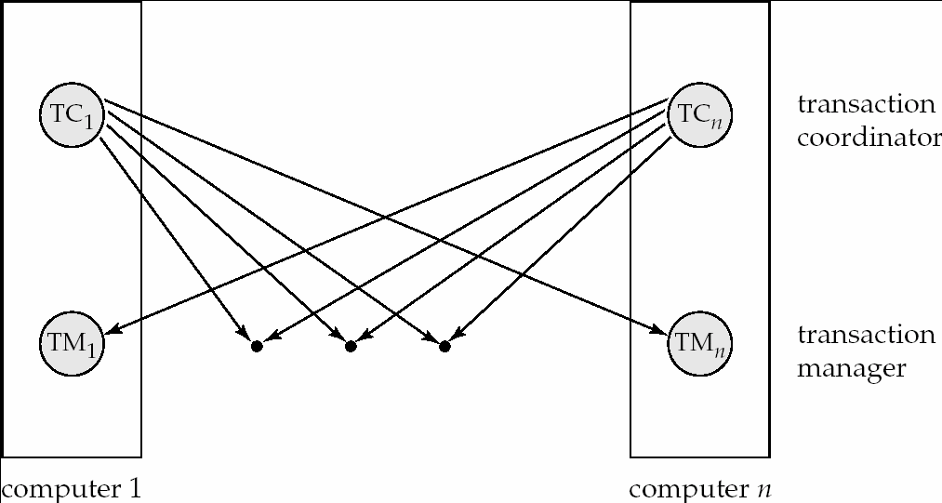
Transaction System Architecture

Slide 23
Commit Protocols
Commit protocols are used to ensure atomicity across sites
a transaction which executes at multiple sites must either be committed at all the sites, or aborted at all the sites.
not acceptable to have a transaction committed at one site and aborted at another
The two-phase commit (2PC) protocol is widely used
The three-phase commit (3PC) protocol is more complicated and more expensive, but avoids some drawbacks of two-phase commit protocol. This protocol is not used in practice.

Slide 24
Two Phase Commit Protocol (2PC)
Assumes fail-stop model – failed sites simply stop working, and do not cause any other harm, such as sending incorrect messages to other sites.
Execution of the protocol is initiated by the coordinator after the last step of the transaction has been reached.
The protocol involves all the local sites at which the transaction executed
Let T be a transaction initiated at site S_{i}, and let the transaction coordinator at S_{i} be C_{i}

Slide 25
Phase 1: Obtaining a Decision
Coordinator asks all participants to prepare to commit transaction T_{i}.
C_{i} adds the records <prepare T> to the log and forces log to stable storage
sends prepare T messages to all sites at which T executed
Upon receiving message, transaction manager at site determines if it can commit the transaction
if not, add a record <no T> to the log and send abort T message to C_{i}
if the transaction can be committed, then:
add the record <ready T> to the log
force all records for T to stable storage
send ready T message to C_{i}

Slide 26
Phase 2: Recording the Decision
T can be committed of C_{i} received a ready T message from all the participating sites: otherwise T must be aborted.
Coordinator adds a decision record, <commit T> or <abort T>, to the log and forces record onto stable storage. Once the record stable storage it is irrevocable (even if failures occur)
Coordinator sends a message to each participant informing it of the decision (commit or abort)
Participants take appropriate action locally.

Slide 27
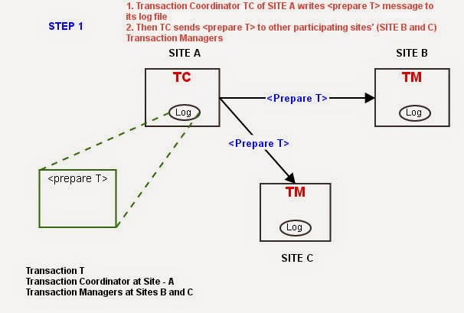

Slide 28
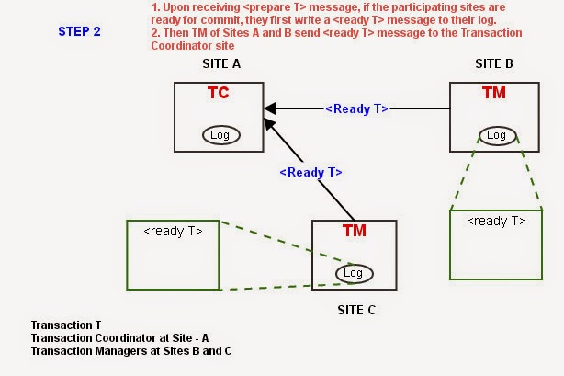

Slide 29
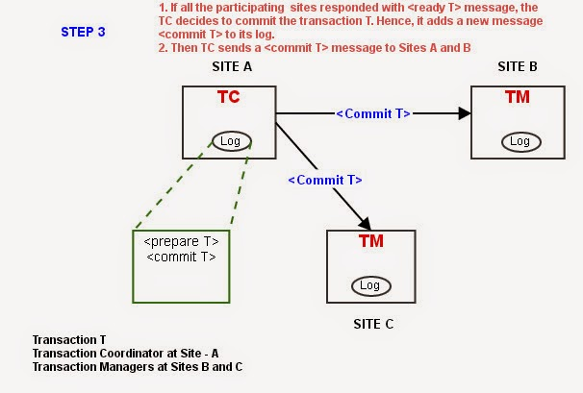

Slide 30
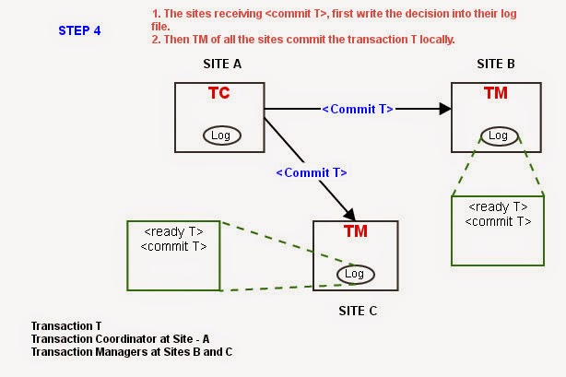

Slide 31
Two Phase Commit (2PC) protocol aborts the transaction, if any of the participating sites are not ready for a commit. Following are the steps :-

Slide 33
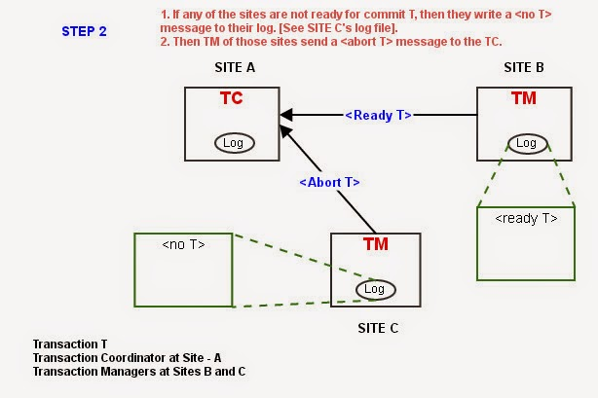

Slide 34
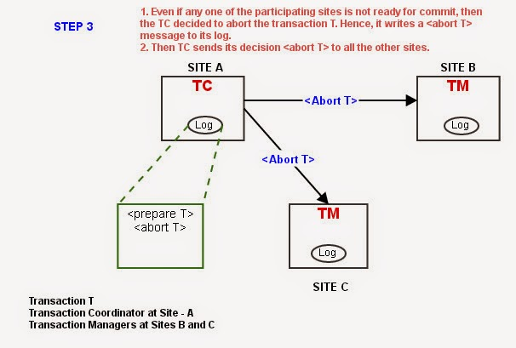

Slide 35
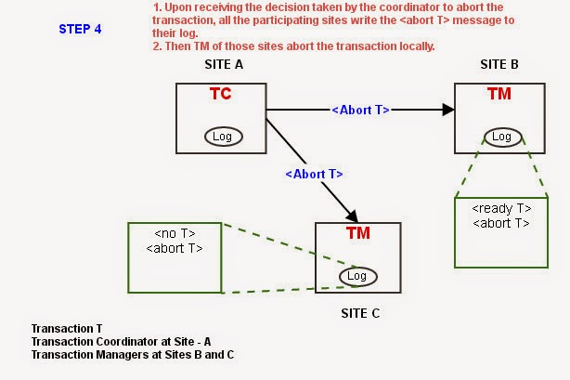

Slide 36
How does 2PC protocol handles failures in distributed database?
Failure of a participating site
Failure of a coordinator
Network partition

Slide 37
Failure of a participating site
There are two things we need to look into to handle such failure:-
1. The response of the Transaction Coordinator of transaction T.
If the failed site have not sent any <ready T> message, the TC cannot decide to commit the transaction. Hence, the transaction T should be aborted and other participating sites to be informed.
If the failed site have sent a <ready T> message, the TC can assume that the failed site also was ready to commit, hence the transaction can be committed by TC and the other sites will be informed to commit. In this case, the site which recovers from failure has to execute the 2PC protocol to set its local database up-to-date.

Slide 38
Failure of a participating site
2. The response of the failed site when it recovers.
The recovering site Si must identify the fate of the transactions which were going on during the failure of Si. This can be done by examining the log file entries of site Si.
The following are the possible cases and relevant actions:-
A) If the log contains a <commit T> entry - It means that all the other sites including Si have responded with <ready T> message to TC and TC must have send <commit T> to all the participants. Because, the participating sites are not allowed to insert <commit T> message in the log file without the coordinator’s decision. Hence, the recovered site Si can perform redo(T). That is, T is executed once again locally by Si.

Slide 39
Failure of a participating site
B) If the log contains an <abort T> entry – Any site can have <abort T> message in its entry, if the decision taken by the coordinator TC is to abort the transaction T. Hence, site Si executes undo(T).
C) If the log contains a <ready T> entry – This means that the site Si failed immediately after sending its own status on transaction T. Now, it has contact the TC or other sites for deciding the fate of the transaction T.
The first choice is to contact the TC of transaction T. If the TC have an entry <commit T>, then according to the above discussions, it is clear that the Si have to perform redo(T). If the TC have an entry <abort T>, then Si performs undo(T).
The second choice is to contact the other sites which have participated in transaction T (this choice is chosen only if TC is not available). Then the decision can be taken based on the other sites’ log entries.
D) If the log contains no control messages, i.e, no <abort T>, <commit T>, or <ready T> - It clearly shows that the site Si has failed well before responding to the <prepare T> message. Hence, the TC must have aborted the transaction. So, Si needs to execute a undo(T).
This is how the 2PC handles the failure of a participating Site.

Slide 40
Handling of Failures - Site Failure
When site S_{i} recovers, it examines its log to determine the fate of transactions active at the time of the failure.
Log contain <commit T> record: site executes redo (T)
Log contains <abort T> record: site executes undo (T)
Log contains <ready T> record: site must consult C_{i} to determine the fate of T.
If T committed, redo (T)
If T aborted, undo (T)
The log contains no control records concerning T replies that S_{k} failed before responding to the prepare T message from C_{i}
since the failure of S_{k} precludes the sending of such a response C₁ must abort T
S_{k} must execute undo (T)

Slide 41
Handling the Failure of a Coordinator Site
Let us suppose that the Coordinator Site failed during execution of 2 Phase Commit (2PC) protocol for a transaction T.
This situation can be handled in two ways:-
1. The other sites which are participating in the transaction T may try to decide the fate of the transaction. That is, they may try to decide on Commit or Abort of T using the control messages available in every site.
2. The second way is to wait until the coordinator site recovers.

Slide 42
Handling the Failure of a Coordinator Site
1.
A) If an active site has <commit T> message in its log - <commit T> message is decided by the coordinator site. If the coordinator site sends the <commit T> message to all the participating sites, then only they can write the message into their log files. Hence, the decision is to commit the transaction T.
B) If an active site recorded <abort T> message in its log – This clearly shows that the decision taken by the coordinator site before it fails was to abort the transaction T. Hence, the decision should be abort T.
C) If some active sites do not hold a <ready T> message in their log files – As stated in 2PC protocol, if one or more of the participating sites do not contain <ready T> message in their log files, then it clearly shows that those sites must not have responded to the coordinator on the <prepare T> message. Hence, the coordinator must have taken a decision to abort the transaction T. So, we abort T.

Slide 43
Handling the Failure of a Coordinator Site
2.
If none of the cases A) ,B) , C) holds, we can apply only the second way of handling the failure of coordinator site. That is, we need to wait until the transaction coordinator recovers.

Slide 44
Handling of Failures- Coordinator Failure
If coordinator fails while the commit protocol for T is executing then participating sites must decide on T’s fate:
If an active site contains a <commit T> record in its log, then T must be committed.
If an active site contains an <abort T> record in its log, then T must be aborted.
If some active participating site does not contain a <ready T> record in its log, then the failed coordinator C_{i} cannot have decided to commit T. Can therefore abort T.
If none of the above cases holds, then all active sites must have a
<ready T> record in their logs, but no additional control records (such as <abort T> of <commit T>). In this case active sites must wait for C_{i} to recover, to find decision.
Blocking problem : active sites may have to wait for failed coordinator to recover.

Slide 45
Handling of Network Partition Failure
It refers to the failure of a network device that leads to the break of one network into two.
During the execution of a transaction T, if any Network Partition happens, then there are two possibilities of execution of transaction T.
Possibility 1
The coordinator site and all the other participating sites may belong to one of the partitions. That is, no sites are disconnected from the other physically. For this case, we do not need to worry. The reason is, all the components executing transaction T are available in one partition. Hence, 2PC does not have anything to do with this failure.
Possibility 2
The coordinator site and all the other participating sites may belong to several partitions. In this case, the Network Partition affects the execution.
Now, the sites that are in a partition which is disconnected from coordinator execute 2PC for handling coordinator failure.

Slide 46
Handling of Failures - Network Partition
If the coordinator and all its participants remain in one partition, the failure has no effect on the commit protocol.
If the coordinator and its participants belong to several partitions:
Sites that are not in the partition containing the coordinator think the coordinator has failed, and execute the protocol to deal with failure of the coordinator.
 No harm results, but sites may still have to wait for decision from coordinator.
The coordinator and the sites are in the same partition as the coordinator think that the sites in the other partition have failed, and follow the usual commit protocol.
 Again, no harm results

Slide 47
Recovery and Concurrency Control
In-doubt transactions have a <ready T>, but neither a <commit T>, nor an <abort T> log record.
The recovering site must determine the commit-abort status of such transactions by contacting other sites; this can slow and potentially block recovery.
Recovery algorithms can note lock information in the log.
Instead of <ready T>, write out <ready T, L> L = list of locks held by T when the log is written (read locks can be omitted).
For every in-doubt transaction T, all the locks noted in the <ready T, L> log record are reacquired.
After lock reacquisition, transaction processing can resume; the commit or rollback of in-doubt transactions is performed concurrently with the execution of new transactions.

Slide 48
Concurrency Control
Modify concurrency control schemes for use in distributed environment.
We assume that each site participates in the execution of a commit protocol to ensure global transaction automicity.
We assume all replicas of any item are updated
Single-Lock-Manager Approach
System maintains a single lock manager that resides in a single chosen site, say S_{i}
When a transaction needs to lock a data item, it sends a lock request to S_{i} and lock manager determines whether the lock can be granted immediately
If yes, lock manager sends a message to the site which initiated the request
If no, request is delayed until it can be granted, at which time a message is sent to the initiating site
The transaction can read the data item from any one of the sites at which a replica of the data item resides.
Writes must be performed on all replicas of a data item
On successful completion of transaction, the Transaction manager of initiating site can release the lock through unlock request to the lock-manager site.

Slide 49
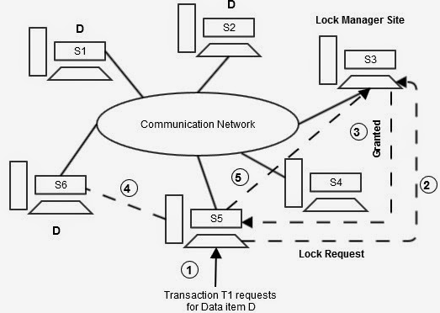
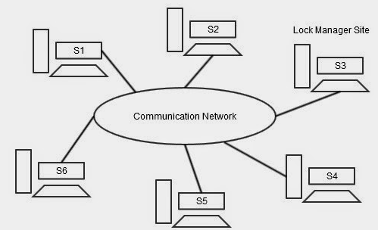

Slide 50
Advantages:
Locking can be handled easily. We need two messages for lock (one for request, the other for grant), and one message for unlock requests. Also, this method is simple as it resembles the centralized database.
Deadlocks can be handled easily. The reason is, we have one lock manager who is responsible for handling the lock requests.
Disadvantages:
The lock-manager site becomes the bottleneck as it is the only site to handle all the lock requests generated at all the sites in the system.
Highly vulnerable to single point-of-failure. If the lock-manager site failed, then we lose the concurrency control.

Slide 51
Distributed Lock Manager
In this approach, the function of lock-manager is distributed over several sites.
[Every DBMS server (site) has all the components like Transaction Manager, Lock-Manager, Storage Manager, etc.]
In Distributed Lock-Manager, every site owns the data which is stored locally.
This is true for a table that is fragmented into n fragments and stored in n sites. In this case, every fragment is unique from every other fragment and completely owned by the site in which it is stored. For those fragments, the local Lock-Manager is responsible to handle lock and unlock requests generated by the same site or by other sites.
If the data stored in a site is replicated in other sites, then a site cannot own the data completely. In such case, we cannot handle any lock request for a data item stored in a site as the case of fragmented data. If we handle like fragmented data, it leads to inconsistency problems as there are multiple copies stored in several sites. This case can be handled using several protocols which are specifically designed for handling lock requests on replicated data. The protocols are, Primary copy, Majority protocol, Biased protocol, Quorum consensus

Slide 52

Distributed Lock Manager
Advantages:
Simple implementation is required for the data which are fragmented. They can be handled as in the case of Single Lock-Manager approach.
For replicated data, again the work can be distributed over several sites using one of the above listed protocols.
Lock-Manager site is not the bottleneck as the work of lock-manager is distributed over several sites.
Disadvantages:
Handling of Deadlock is difficult, because, a transaction T1 which acquired a lock on a data item Q at site S1 may be waiting for lock on another data item R as site S2. This wait is genuine or a deadlock has occurred is not easily identifiable.

